Slide 1
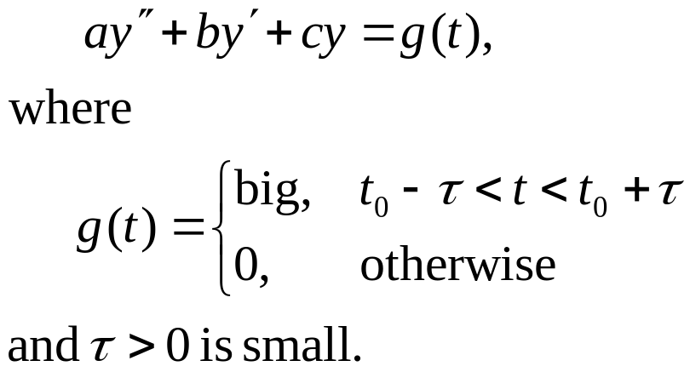
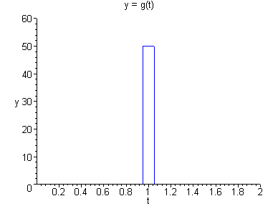
Ch 6.5: Impulse Functions
In some applications, it is necessary to deal with phenomena of an impulsive nature.
For example, an electrical circuit or mechanical system subject to a sudden voltage or force g(t) of large magnitude that acts over a short time interval about t₀. The differential equation will then have the form
Like hit and run

Slide 2
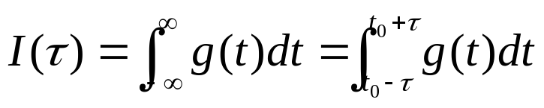
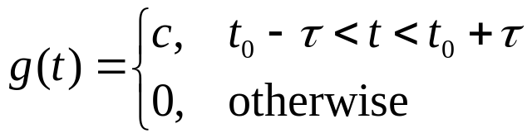
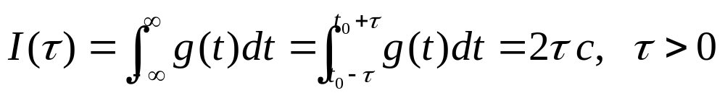
Measuring Impulse
In a mechanical system, where g(t) is a force, the total impulse of this force is measured by the integral
Note that if g(t) has the form
then
In particular, if c = 1/(2τ), then I(τ) = 1 (independent of τ ).

Slide 3
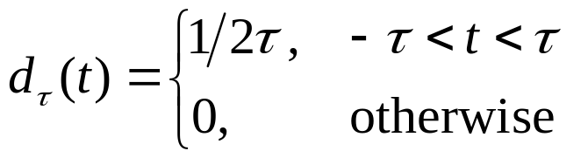
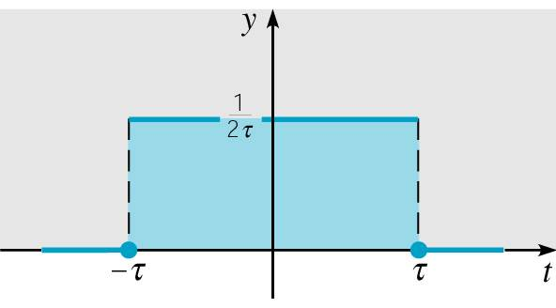
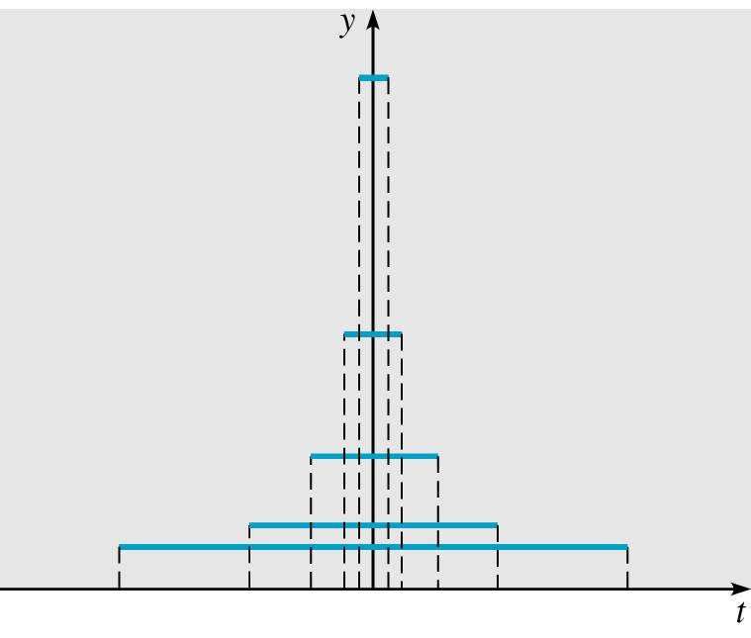
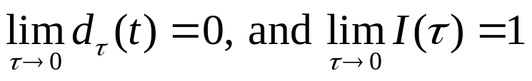
Unit Impulse Function
Suppose the forcing function d_{τ}(t) has the form
Then as we have seen, I(τ) = 1.
We are interested d_{τ}(t) acting over
shorter and shorter time intervals
(i.e., τ → 0). See graph on right.
Note that d_{τ}(t) gets taller and narrower
as τ → 0. Thus for t ≠ 0, we have

Slide 4
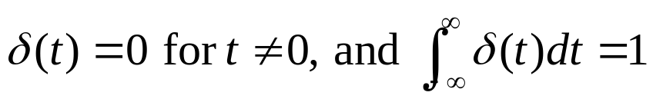
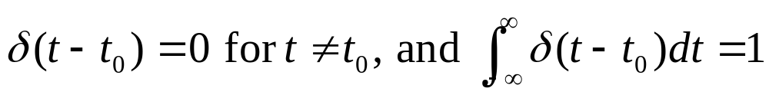
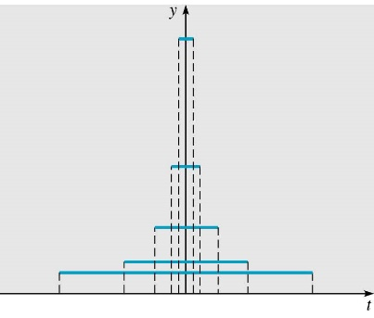
Dirac Delta Function
Thus for t ≠ 0, we have
The unit impulse function δ is defined to have the properties
The unit impulse function is an example of a generalized function and is usually called the Dirac delta function.
In general, for a unit impulse at an arbitrary point t₀,

Slide 5
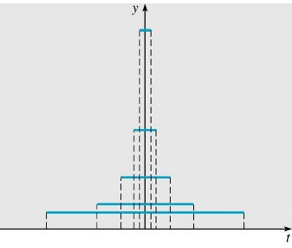
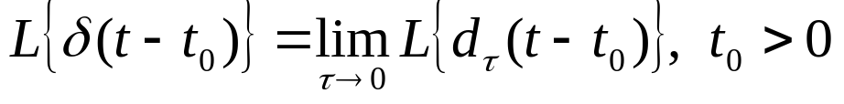
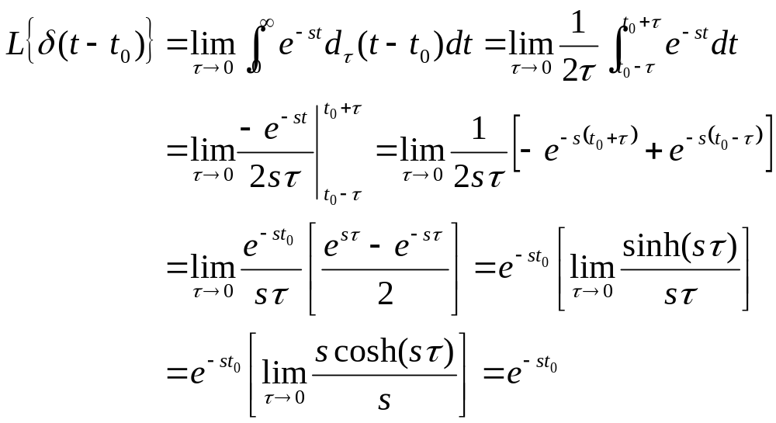
Laplace Transform of δ (1 of 2)
The Laplace Transform of δ is defined by
and thus

Slide 6

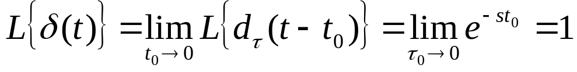
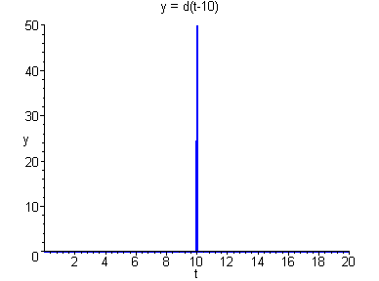
Laplace Transform of δ (2 of 2)
Thus the Laplace Transform of δ is
For Laplace Transform of δ at t₀= 0, take limit as follows:
For example, when t₀= 10, we have L{δ(t -10)} = e^{-10s}.

Slide 7
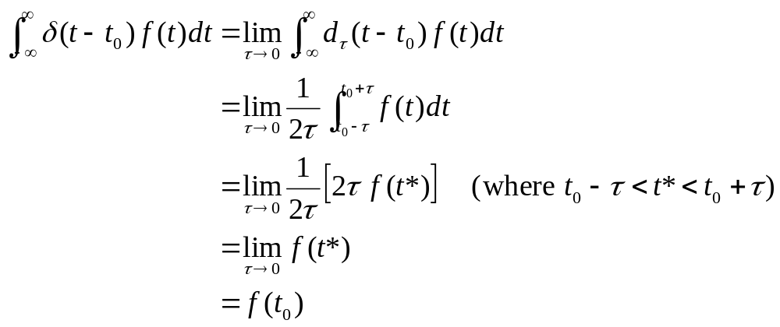
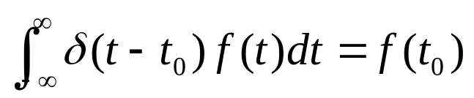
Product of Continuous Functions and δ
The product of the delta function and a continuous function f can be integrated, using the mean value theorem for integrals:
Thus

Slide 8

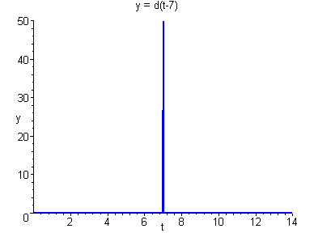
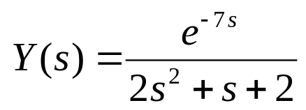
Example 1: Initial Value Problem (1 of 3)
Consider the solution to the initial value problem
Then
Letting Y(s) = L{y},
Substituting in the initial conditions, we obtain
or

Slide 9
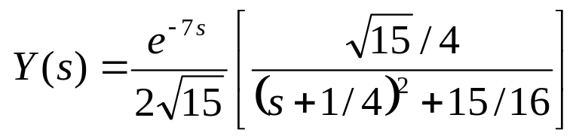
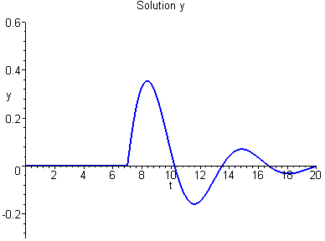
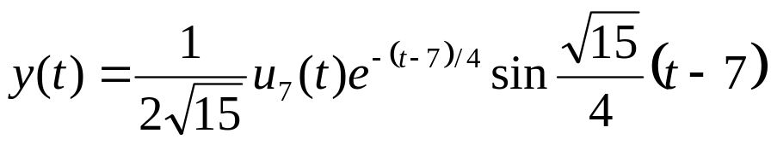
Example 1: Solution (2 of 3)
We have
The partial fraction expansion of Y(s) yields
and hence

Slide 10
Example 1: Solution Behavior (3 of 3)
With homogeneous initial conditions at t = 0 and no external excitation until t = 7, there is no response on (0, 7).
The impulse at t = 7 produces a decaying oscillation that persists indefinitely.
Response is continuous at t = 7 despite singularity in forcing function. Since y' has a jump discontinuity at t = 7, y'' has an infinite discontinuity there. Thus singularity in forcing function is balanced by a corresponding singularity in y''.

